Slide 1

DATA ANALYSIS
U S I N G S Q L
BY ANISH KULKARNI

Slide 2
SKILLS
SQL
Data engineering
Data visualization
Data Analysis
Extracting insights from complex datasets for informed decisions
Database management, queries, and optimization skills
Transforming raw data into valuable, actionable information.
Conveying insights through compelling, informative graphical representations

Slide 3

DATASET
SU P ER ST OR E DATA
In today's rapidly evolving business landscape, a Superstore Giant recognizes the critical importance of data analysis in gaining a competitive edge. They seek your expertise to navigate the intricate maze of market dynamics. Your role involves not only deciphering which products resonate most with customers but also identifying lucrative regions, optimizing product categories, and honing in on the most profitable customer segments.
Through meticulous data analysis, you'll unearth valuable insights, transforming raw data into actionable information. Your findings will drive strategic decisions, enabling the Superstore Giant to fine-tune their approach, minimize risks, and maximize profitability. Your mastery of data analysis will be the compass guiding this retail giant toward sustainable success in a dynamic market.

Slide 4

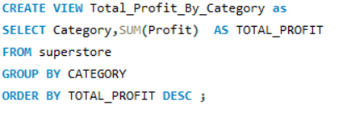
TOTAL PROFIT BY CATEGORY

Slide 5
TOTAL PROFIT BY Category

Slide 6
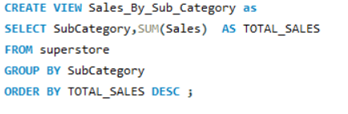
SALES BY SUB-CATEGORY

Slide 7
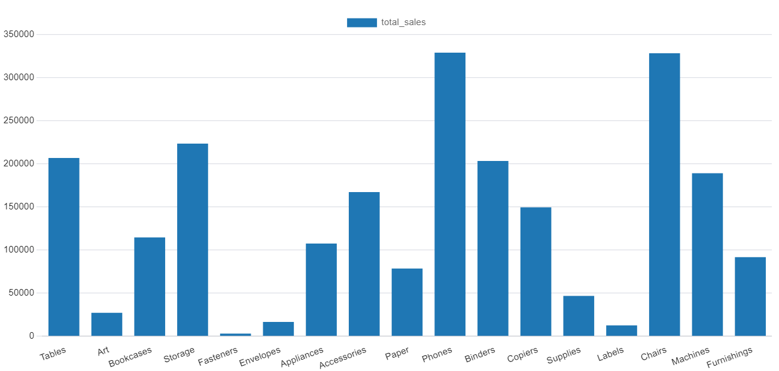
SALES BY SUB-CATEGORY

Slide 8
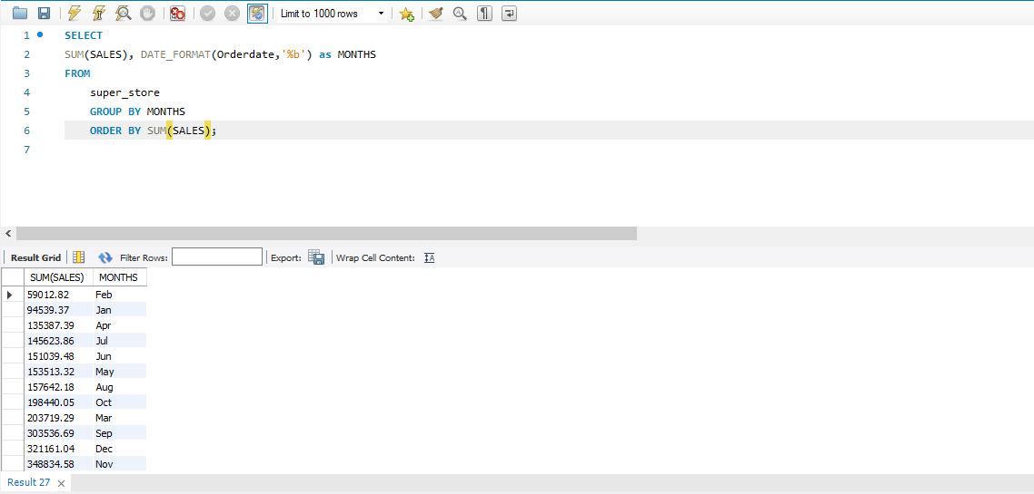
SALES TREND BY MONTH

Slide 10
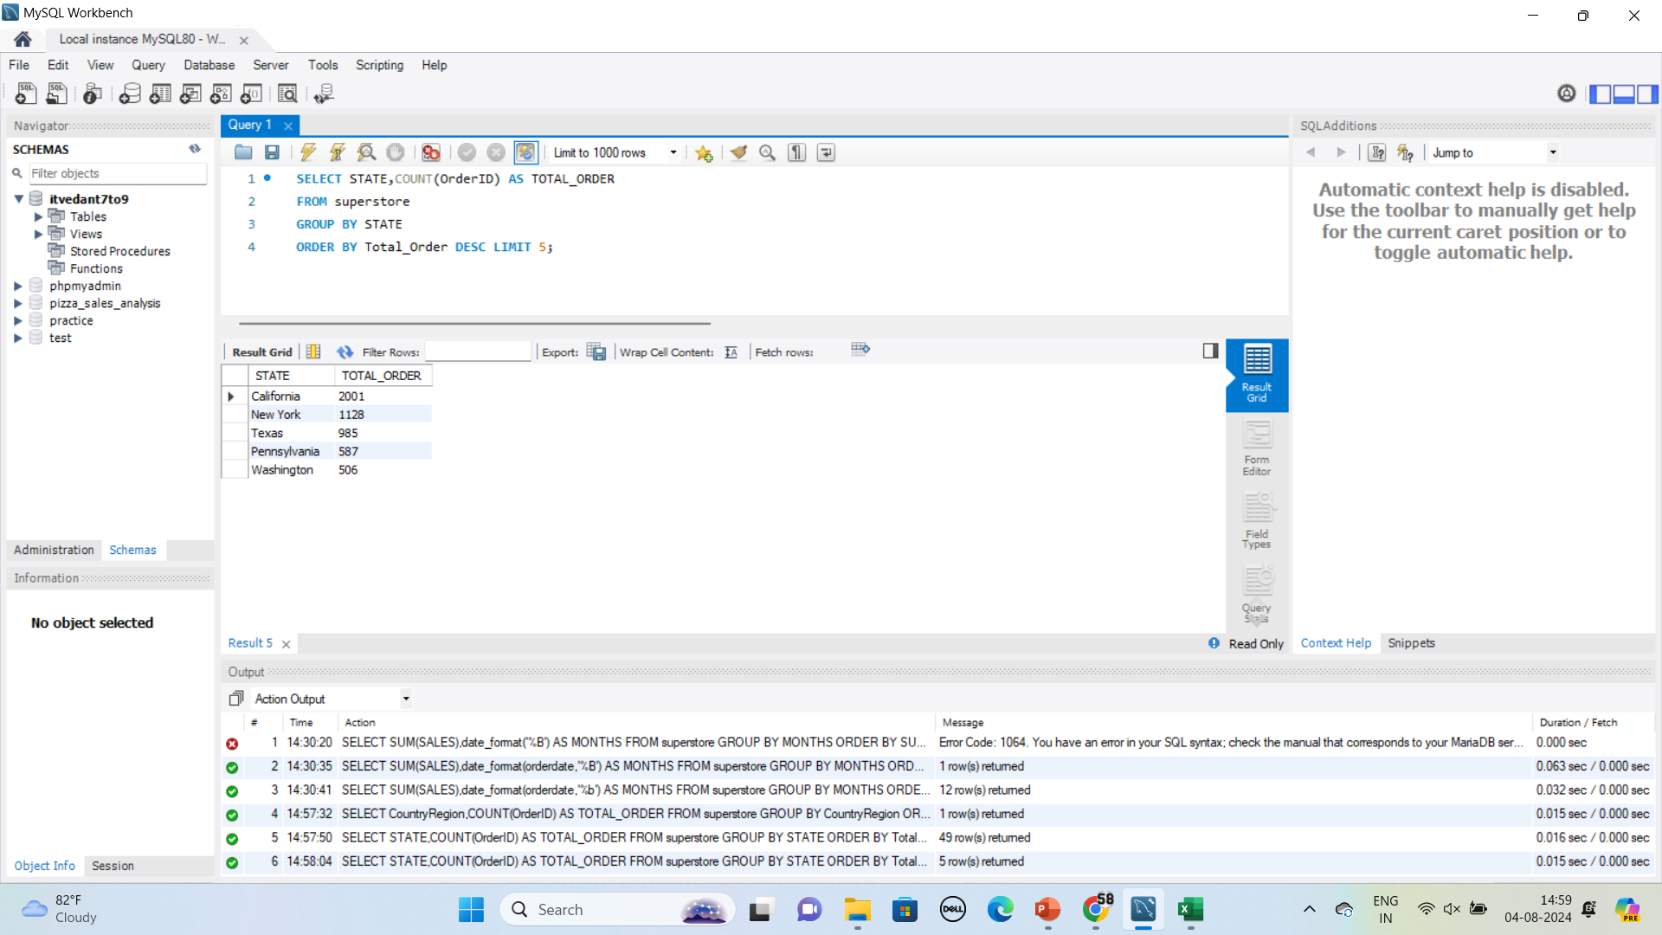
TOP 5 STATES BY SALES

Slide 12
THANK YOU

